Slide 1



Information Communication Technology
(CSC101)
Lecture 5
Instructor: Mariam Fiaz
email: mariamsherwani434@gmail.com

Slide 2


Reference Books:
  Understanding Computers: Today and Tomorrow, Comprehensive – Deborah Morley & Charles S. Parker, Cengage Learning, 2017 (Read Chapters 7, 8)

Slide 3
Contents:
Networking Concepts
Networking Applications
Network Characteristics
  3.1 Network Architectures (Client-Server, Peer-to-Peer)
  3.2 Network Topologies (with examples)
  3.3 Network Size & Coverage Area (PAN, LAN, MAN, WAN)
Data Transmission Characteristics
Networking Media
Communication Protocols & Standards
Networking Hardware (with functions)
Summary of the Lecture

Slide 4
Networking Concepts:
Definition: Computer Network
A computer network is a system in which multiple computers and devices are connected to share data, resources, and communication services.
What a network does
Shares files and printers
Enables internet access
Supports communication (email, video calls)
Connects devices using cables or wireless signals
Example: School computer lab where all computers share one printer.

Slide 5
Networking Applications:
Telecom Industry
Definition: Use of networks for long-distance communication.
What it does:
Mobile calls and messaging
Internet services
Data transmission worldwide
Example: Mobile network providers connect users across cities.

Slide 6
Networking Applications:
2. Videoconferencing
Definition: Real-time communication using video and audio over a network.
What it requires:
High bandwidth
Camera + microphone
Stable internet
Example: Online classes, Zoom meetings.

Slide 7
Networking Characteristics:
Network Architectures
Network Topologies
Network Size & Coverage Area

Slide 8
1- Network Architecture:
1. Client-Server Network
Definition: A network where a central server manages data and services for clients.
What it does:
Stores files centrally
Controls user access
Provides security
Example: Bank database server handling all customer accounts.

Slide 9
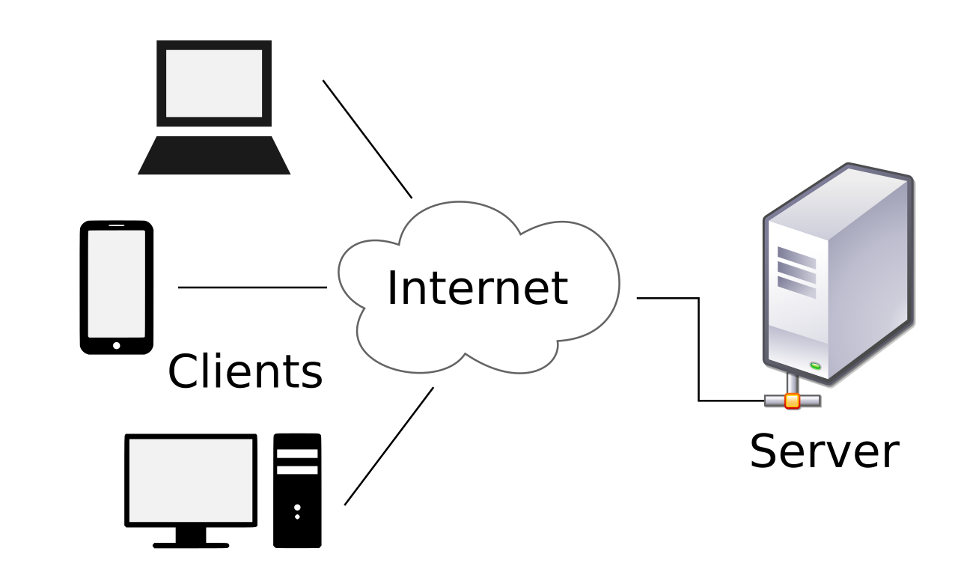

Slide 10
1- Network Architecture:
2. Peer-to-Peer Network
Definition: A network where all computers share resources directly.
What it does:
Each computer acts as client and server
No central control
Example: Home network sharing files between two laptops

Slide 11
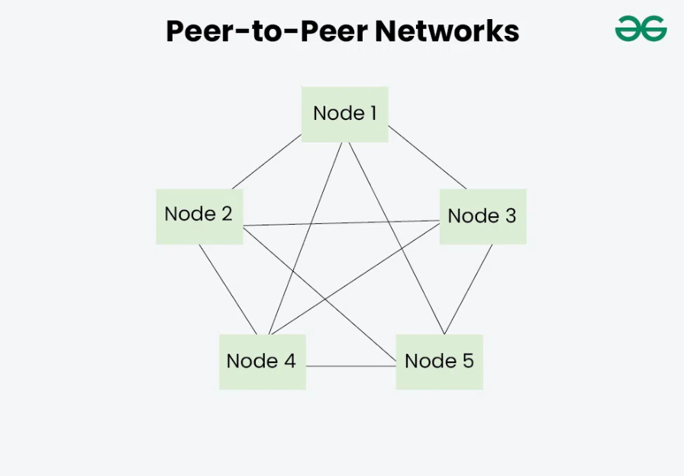

Slide 12
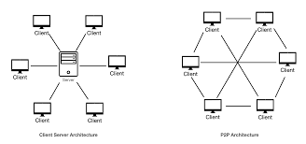
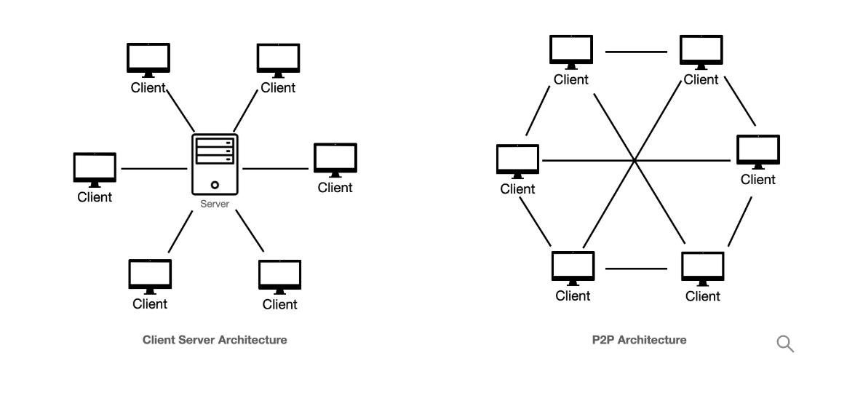

Slide 13
2- Network Topologies:
1. Bus Topology
Definition: All devices are connected to a single backbone cable. How it works: Data travels along one main line; every device listens.
Advantages: Low cost, simple setup.
Disadvantages: If backbone fails, whole network stops.
Real-life Example: Small temporary lab setup using one shared cable.

Slide 14
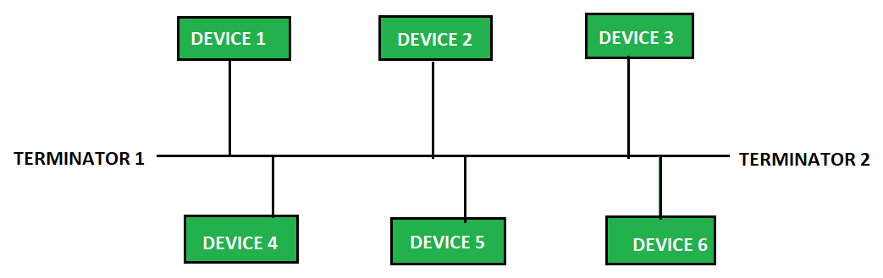

Slide 15
2- Network Topologies:
2. Star Topology
Definition: All devices connect to a central device (hub/switch). How it works: Central device receives and forwards data to the correct device.
Advantages: Easy to manage, failure of one cable doesn’t stop others.
Disadvantages: If central device fails, network stops.
Real-life Example: Modern school or office LAN using a switch.

Slide 16
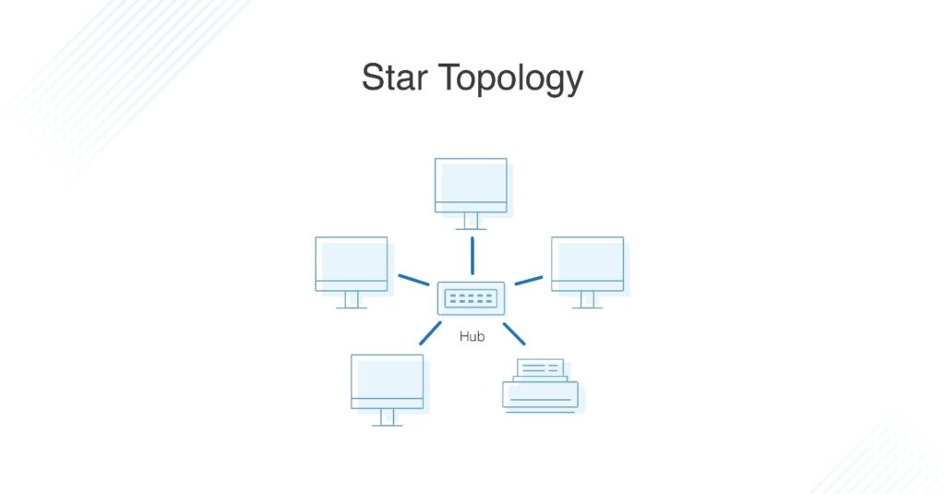

Slide 17
2- Network Topologies:
3. Ring Topology
Definition: Devices form a closed loop (circle).
How it works: Data passes from one device to the next around the ring.
Advantages: Orderly data flow, equal access.
Disadvantages: One break can disrupt the ring (unless dual ring). Real-life Example: Token Ring–style networks (legacy systems).

Slide 18
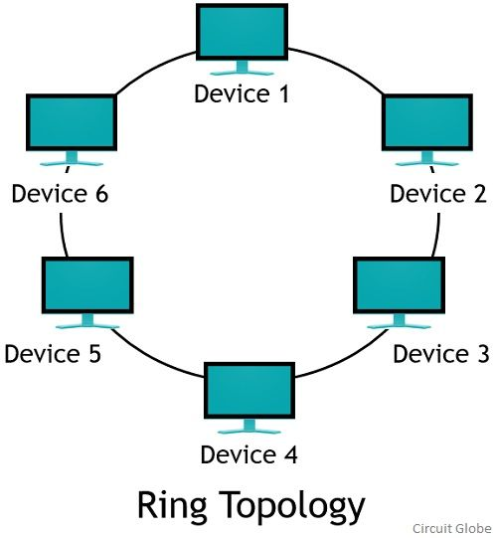

Slide 19
2- Network Topologies:
4. Mesh Topology
Definition: Each device connects to multiple other devices.
How it works: Multiple paths exist; data chooses available path. Advantages: Very reliable, high fault tolerance.
Disadvantages: Expensive, complex cabling.
Real-life Example: Internet backbone and critical infrastructure networks.

Slide 20
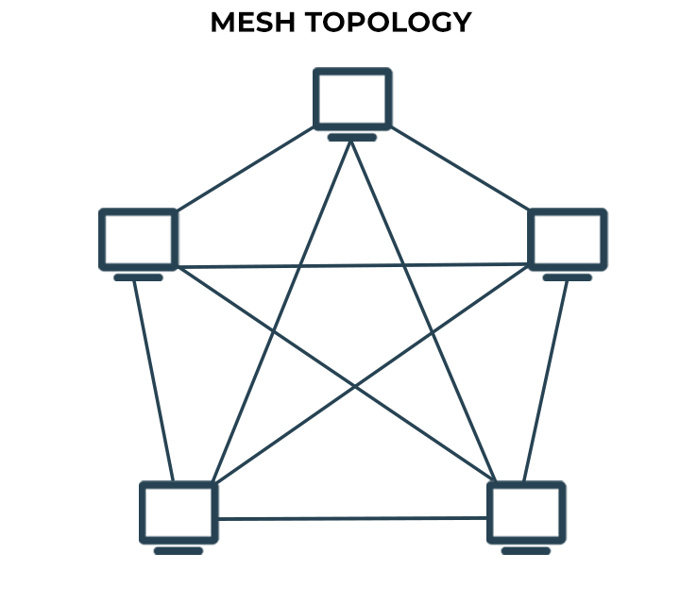

Slide 21
2- Network Topologies:
5. Tree Topology
Definition: Hierarchical topology where multiple star networks are connected to a central backbone (tree-like structure).
How it works: Main backbone connects branches; each branch may have its own star network.
Advantages: Scalable, organized management, easy expansion. Disadvantages: Backbone failure can affect large part of network, complex setup.
Real-life Example: Corporate office building network with floors and departments; university campus network hierarchy.

Slide 22
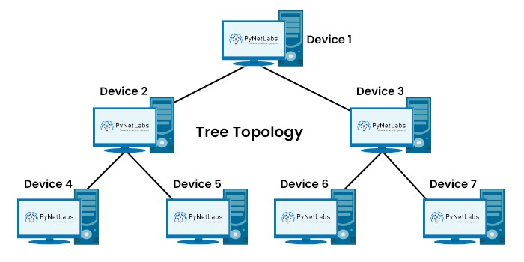

Slide 23
2- Network Topologies:
6. Hybrid Topology
Definition: Combination of two or more topologies.
How it works: Different sections use different layouts (e.g., star + bus).
Advantages: Flexible and scalable.
Disadvantages: Design complexity.
Real-life Example: University campus network (departments in star, buildings linked by backbone).

Slide 24
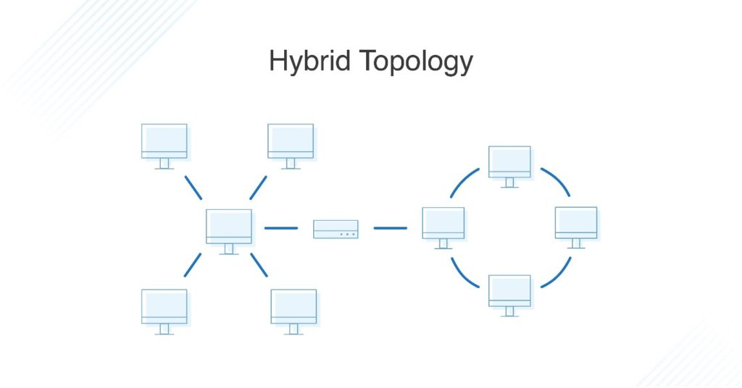

Slide 25
3- Network Size and Coverage Area:
1. PAN (Personal Area Network)
Definition: Very small network around one person.
Example: Bluetooth between a phone and wireless earbuds or smartwatch.
2. LAN (Local Area Network)
Definition: Network within a limited area like a room, building, or campus.
Example: School computer lab or office floor network.

Slide 26
3- Network Size and Coverage Area:
3. MAN (Metropolitan Area Network)
Definition: Network that covers a city or large urban area.
City-style Example: City-wide fiber network connecting universities, hospitals, and government offices across the city.
4. WAN (Wide Area Network)
Definition: Network covering very large geographic areas (countries/continents).
Example: The Internet; a bank’s branches connected nationwide.

Slide 27
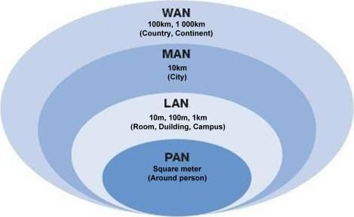

Slide 28
Data Transmission Characteristics:
1. Bandwidth
Definition: Maximum data transfer capacity.
Example: 100 Mbps internet speed.
2. Analog Signal
Definition: Continuous waveform signal.
Example: Radio broadcast.
3. Digital Signal
Definition: Binary signal (0s and 1s).
Example: Computer data transmission.

Slide 29
Data Transmission Characteristics:
4. Transmission Modes
Simplex → Data is transmitted in only one direction (e.g.
TV Broadcast).
Half Duplex → Data can travel in both directions, but only one at a time (e.g. Walkie-talkie).
Full Duplex → Data is transmitted in both directions at the same time (e.g. Phone Call).
5. Delivery Methods
Unicast → email to one person
Broadcast → TV transmission
Multicast → online live class

Slide 30
Networking Media:
1. Wired Media
Twisted Pair → Telephone lines
Coaxial Cable → Cable TV
Fiber Optic → High-speed internet backbone
2. Wireless Media
Radio Waves → Wi-Fi
Microwaves → Satellite communication
Infrared → Remote controls

Slide 31
Communication Protocols and Standards:
Communication Protocol
Definition: A set of rules that defines how data is formatted, transmitted, and received between devices.
Major Protocols
1. TCP/IP (Transmission Control Protocol / Internet Protocol)
• Core protocol suite of the Internet; ensures reliable delivery and addressing.
• Used in all internet communication.

Slide 32
Communication Protocols:
2. HTTP (HyperText Transfer Protocol)
• Transfers web pages between browser and server .
• Used when you open websites.
3. HTTPS (HyperText Transfer Protocol Secure)
• Encrypted version of HTTP for secure web communication.
• Used for online banking/shopping.
4. FTP (File Transfer Protocol)
• Transfers files between computers over a network .
• Uploading website files to a server.

Slide 33
Communication Protocols:
5. SMTP (Simple Mail Transfer Protocol)
• Sends email between mail servers.
• Sending an email.
6. POP3 (Post Office Protocol v3)
• Retrieves emails by downloading to client.
• Basic email download.
7. IMAP (Internet Message Access Protocol)
• Accesses email on server without downloading permanently.
• Sync email across devices.

Slide 34
Communication Protocols and Standards:
Networking Standards
Definition: Standards are agreed rules that make sure devices from different brands work together properly.
Examples: Your phone and home Wi-Fi router can connect easily and communicate properly even if they are from different brands, because they follow the same Wi-Fi rules.

Slide 35
Networking Hardware:
1. Router
Function: Connects different networks and routes data packets based on IP address.
Real Example: Home Wi‑Fi router connecting your LAN to the Internet.
2. Switch
Function: Connects devices in a LAN and forwards data only to the intended device (using MAC address).
Real Example: Office network switch connecting PCs and printers.

Slide 36
Networking Hardware:
3. Hub
Function: Basic connector that broadcasts incoming data to all ports.
Real Example: Legacy small network device (rarely used today).
4. Modem (Modulator–Demodulator)
Function: Converts digital signals ↔ analog signals for transmission over ISP (Internet Service Provider) lines.
Real Example: ISP modem for (Digital Subscriber Line )DSL/Cable connection.

Slide 37
Networking Hardware:
5. Network Interface Card (NIC)
Function: Hardware that enables a device to connect to a network (wired or wireless).
Real Example: Ethernet card in a desktop PC; Wi‑Fi adapter in a laptop.

Slide 38
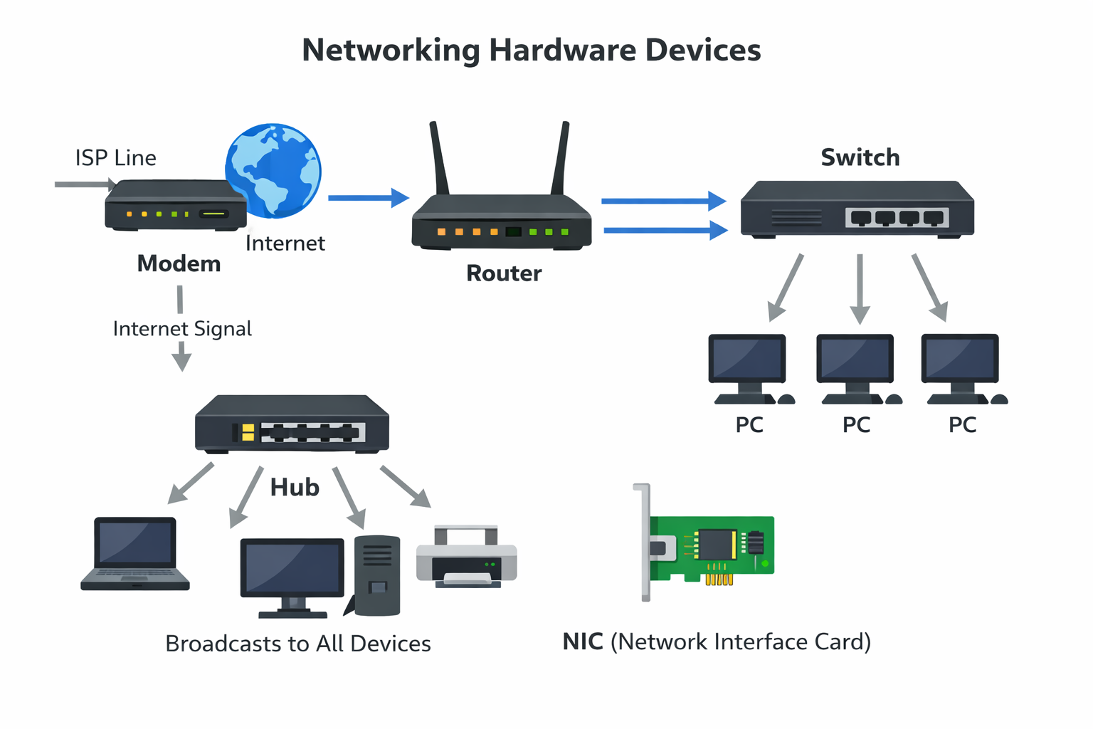

Slide 39
Summary of Lecture 3
Networks connect devices to share data and resources.
Architectures: Client-Server and Peer-to-Peer.
Topologies: Bus, Star, Ring, Mesh, Hybrid.
Coverage: PAN, LAN, MAN (city-wide), WAN (global).
Communication uses protocols (TCP/IP, HTTP/HTTPS, FTP, SMTP) and hardware (router, switch, modem, NIC).

